Slide 1
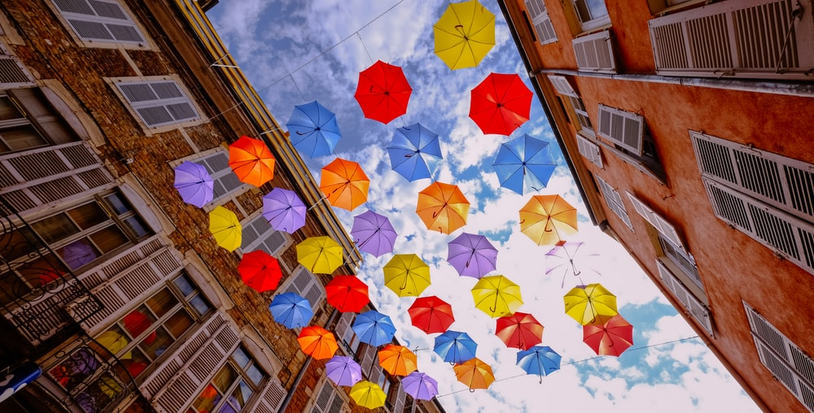
New Agency Identity
Concepts & Activations

Slide 2
Inside all of us is unrealized creative potential – a capacity for incredible growth and fulfillment.

Slide 3
PPO
Purpose
Plan
Outcome
Showcase our vision of a new internal agency.
Review strategic objectives. Present concepts and activations.
Receive initial feedback on presented concepts.

Slide 4
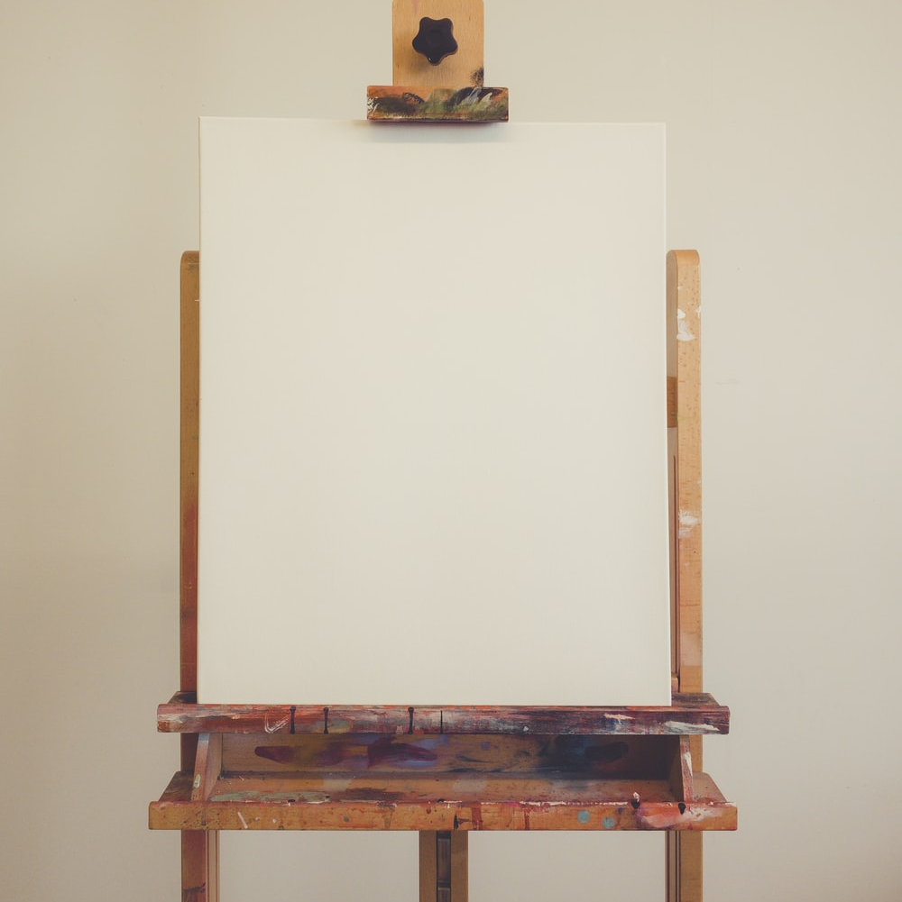


Brief – Manifesto
The blank canvas stares back at us. Asking, what story will you design? Will it inspire? Will it revolutionize? Could it possibly nourish the future with meaning and inspiration and something bigger than oneself?
No child grows up thinking, I want to be ordinary. We’re all wired to believe in the extraordinary. And yet, rarely in life are we given the opportunity – indeed, the responsibility – to truly make a difference.
That’s why the blank canvas is our muse. We, the creative agents of change see the blank canvas and our purpose clearly – to nourish the creative potential in everyone.

Slide 5
Brief – WWCS Role
Inside Herbalife Nutrition, we are a creative community designed to help everyone flourish and achieve their best results.
The Herbalife Worldwide Creative Services vision consists of four pillars:
BUILD
MAKE
CREATE
DESIGN
Build a foundation of trusted servant leaders
Make creativity at the forefront of our business
Create a thriving and innovative culture
Design a creative powerhouse

Slide 6
Concept: Sage

Slide 7
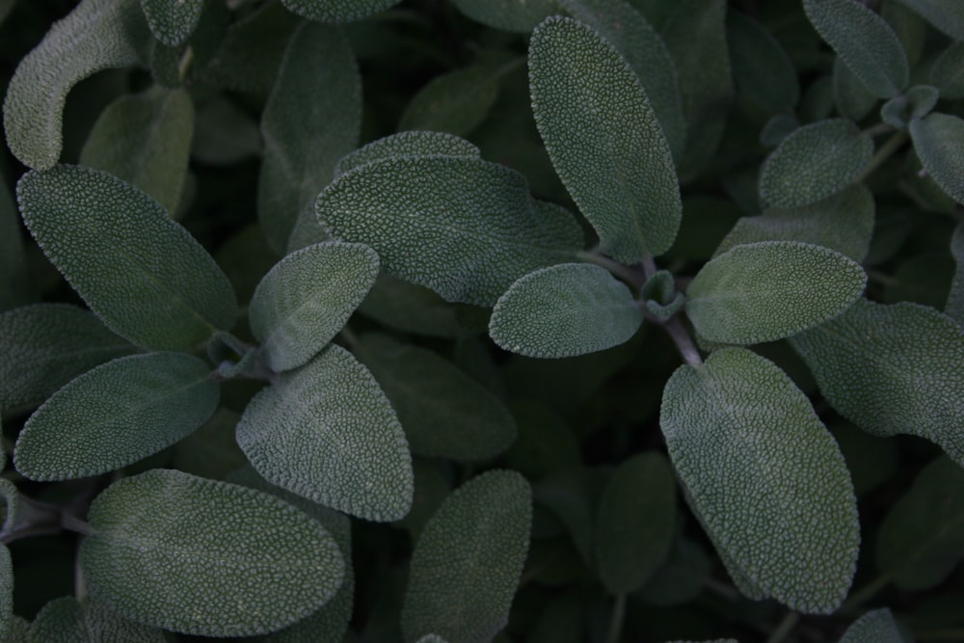
If we want to make creativity the forefront of our business, we need to blend with the rest of Herbalife Nutrition in an exchange of innovation.
Herbs can be antioxidants that purify, also enhancing brain activity and creativity. Not all herbs can stand alone; they need to synthesize with others to create many layers. In order to enhance flavor, they need to let others influence it.

Slide 8
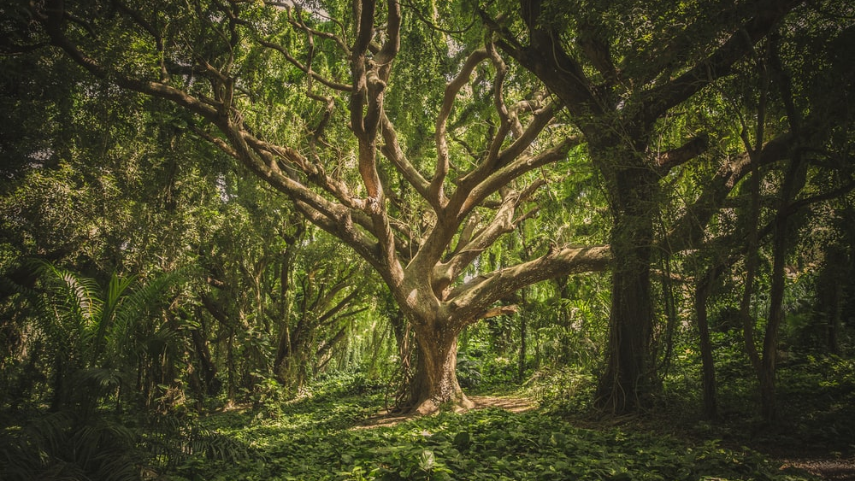
Sharing wisdom requires others to think and expand beyond their comfort zone. Our goal is to guide them. We are continually learning and exploring to seek and share truth. Mutual enrichment is a part of our lifestyle as we lead others on their quest for knowledge, beauty and fulfillment. When we nourish and help them grow, we reach new heights alongside them.
We have the tools, we’re confident in our knowledge, recognize potential and are ready to experiment. Every project is a guided journey that moves our partners to a new creative destination, which in turn becomes the next starting point.

Slide 9
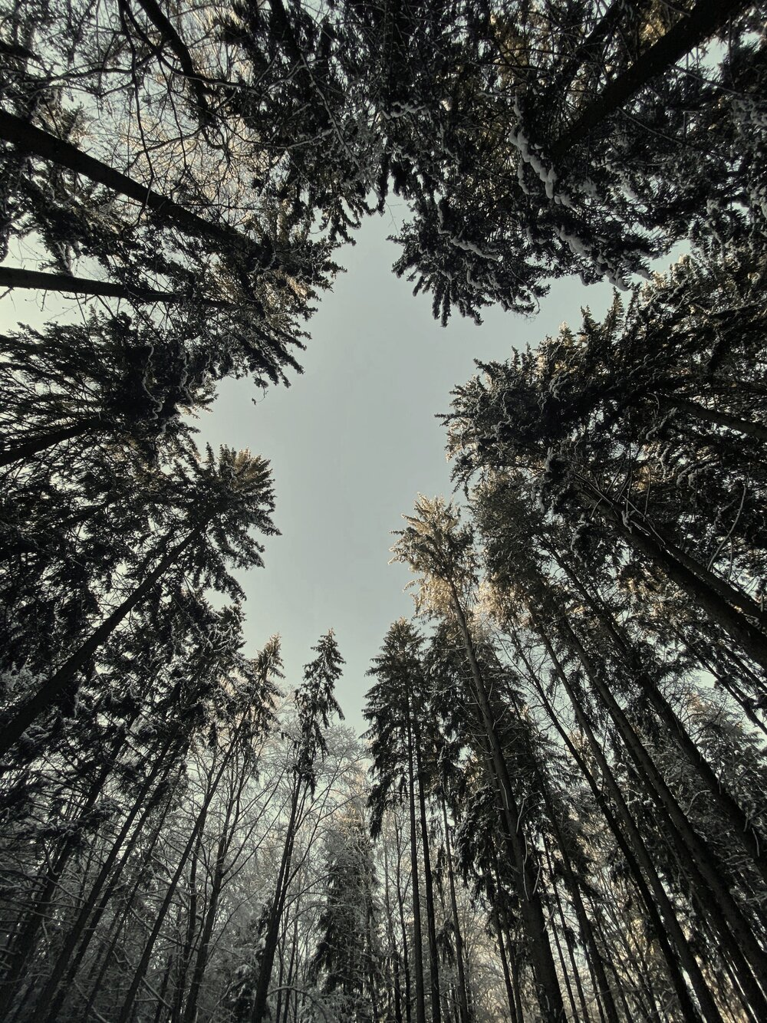
HERBALIFE NUTRITION
CREATIVE REALIZATION
Explore forward.

Slide 10
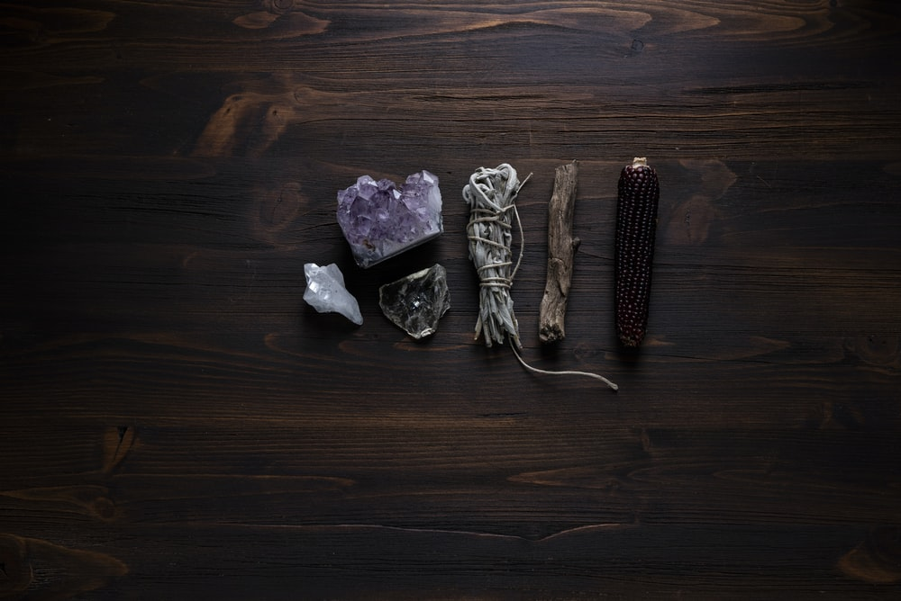
HERBALIFE NUTRITION
CREATIVE REALIZATION
Explore forward.

Slide 11
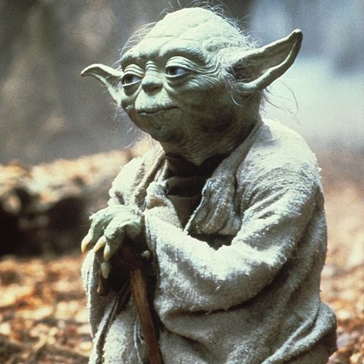
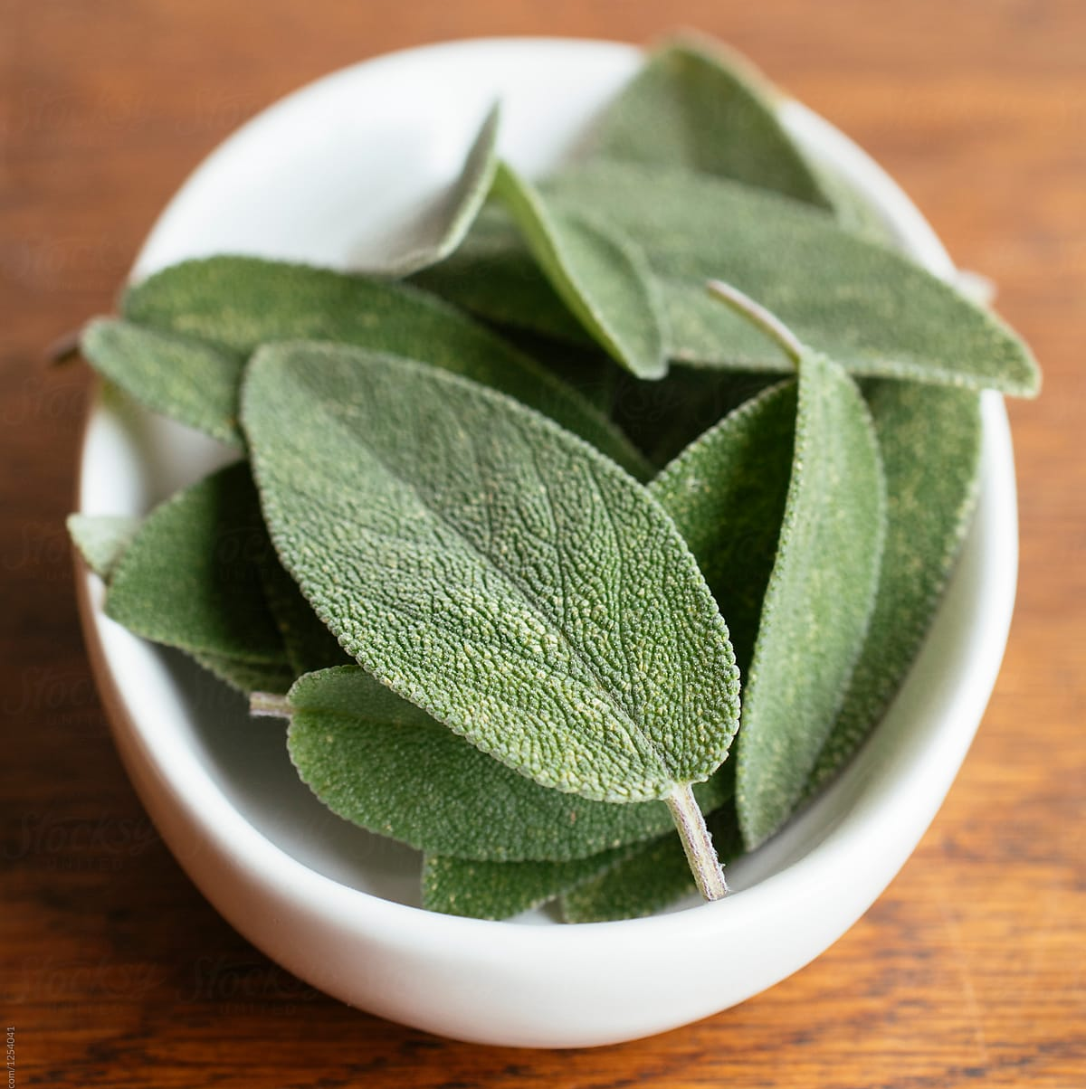
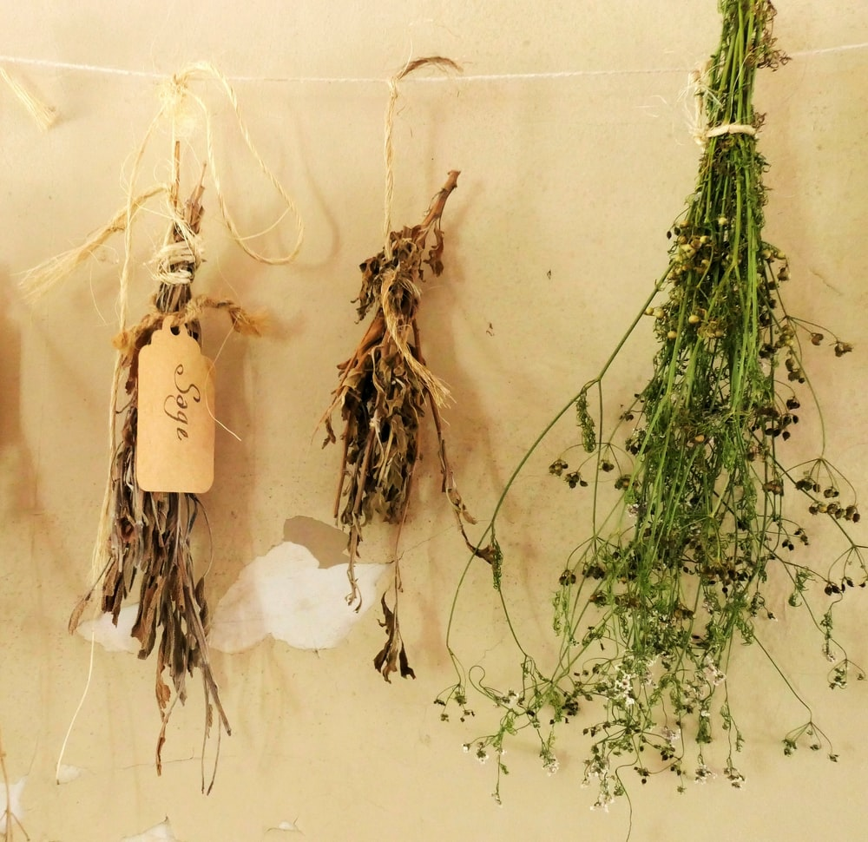
Sage
Why it works and why we like it:
As a word with many meanings, Sage connects with the brand on several fronts. It can be defined as an herb, a philosopher like Jim Rohn, or the color green
We see ourselves as experts who want to guide our partners and nourish their creative journey, with many rewards along the way
The NAM creative department is named after another shade of green, so this is an opportunity to align. We aren’t a carbon copy but are still of the same green family
Sage, as an herb, is connected to creativity and healing

Slide 12
Activation for Sage
Walk in the way of the creative warrior.
Sage will launch a series of heavily publicized challenges in areas of Los Angeles, like the Grove or 3rd Street Promenade, where participants will nourish the balance in their creative soul: nutritional, physical, and emotional.
These medium-skilled challenge events will raise money and awareness for Herbalife Nutrition Foundation and partner with local Casas.
The Sage team will guide the kids through obstacle courses, rock walls and escape rooms. Each activity has designed stops that include wisdom, nutrition, and sometimes just goofy fun.
The goal is to inspire teamwork and build confidence.
Of course, once we are done, the event will be opened to the general public as a ticketed event to raise money for HNF.
The activation would include press releases and video content for social and The Scoop.

Slide 13
Concept: Spaghetti

Slide 14
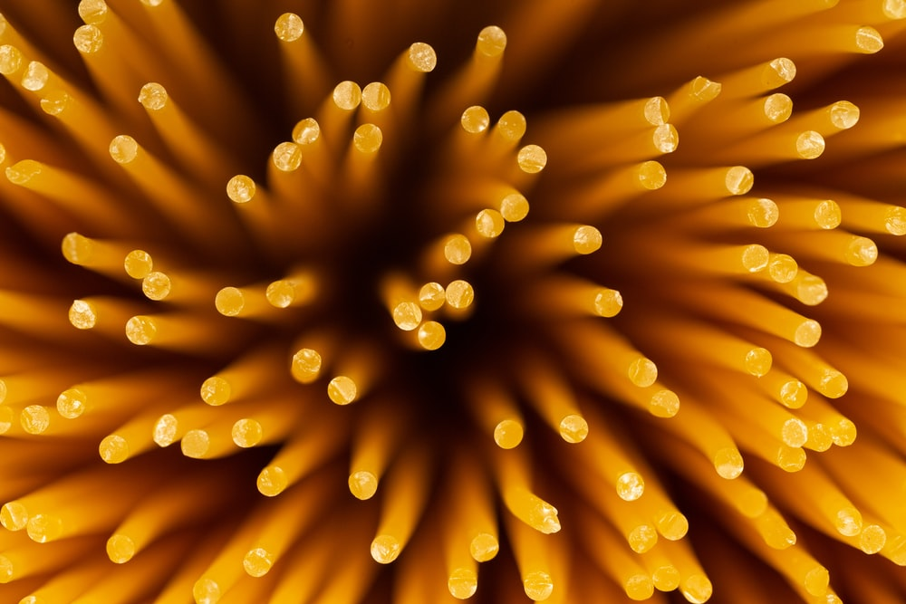
Take a moment and think of your first art form; chalk, fingerpaints, crayons. We remember creating as children because it brought on an infectious joy. It made us smile; it made the adults beam. It scored us a place of honor on the fridge until our next great masterwork came from… who knows where. Nothing was off limits; you made art with whatever was nearby. Newspaper, toilet paper tubes, a rock, your dinner. No matter the medium, art sparks happiness. And at heart, everyone is an artist.
When you nourish the creative spirit, it is a pipeline (or is it a pipe cleaner?) that connects people to remembering how to play. We take a tangle of winding, twisting paths, opinions, flavors, colors and voices and make them boil and bubble. Then we throw it against the wall; sometimes it sticks, other times it bounces to the floor, every time it nourishes our potential.

Slide 15
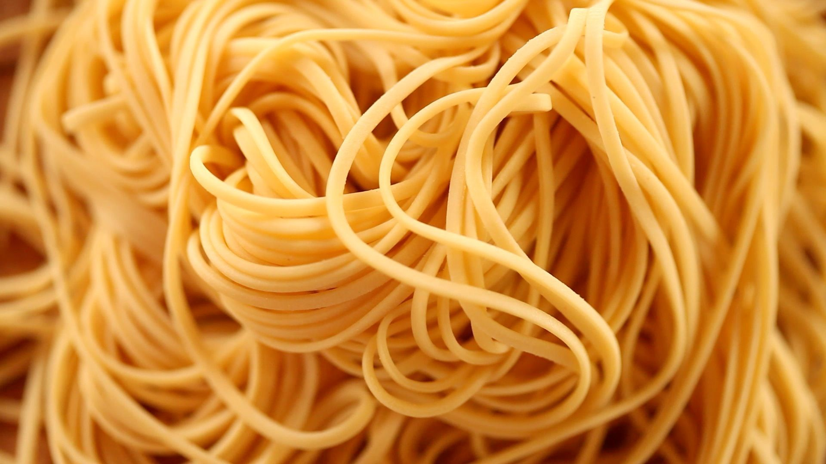
Consider pasta. It’s versatile, kids use it to add dimensions, they stick it to construction paper, string it to make necklaces, paste it to ornaments. It’s yet another way they create art and tell stories.
When you cook it, it can be simple or the starting point for innovation. Boil it in a pot. Add butter, bolognaise, pesto or parmesan and it’s delicious for the whole table. It reaches out in every direction.
When presented, its bundle of strands become a cradle, a support network. No two curve and turn the same way to reach a destination. Like a network, each end connects family, friends, and ideas across the table or around the world.
And it makes us smile. Just like that first masterpiece on the fridge.

Slide 16
HERBALIFE NUTRITION
CREATIVE REALIZATION
Ideas that stick.

Slide 17
Ideas that stick.

Slide 18
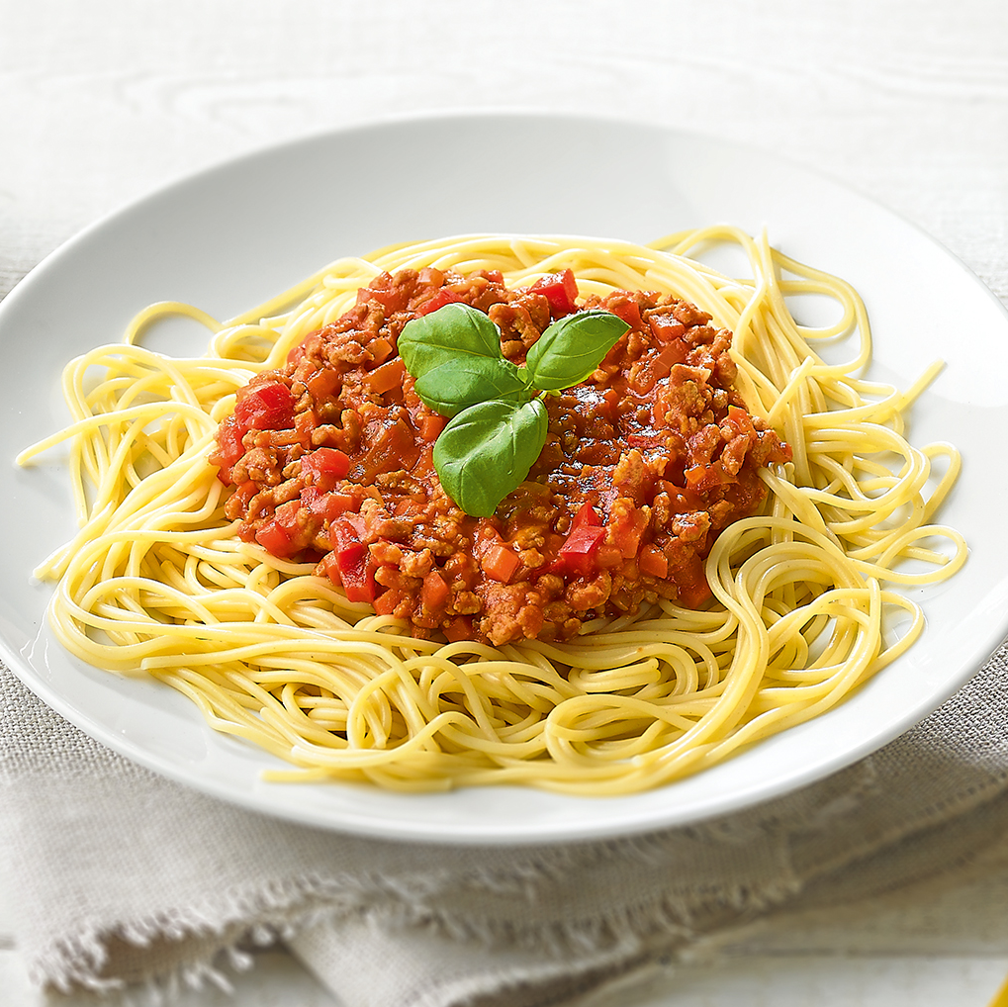
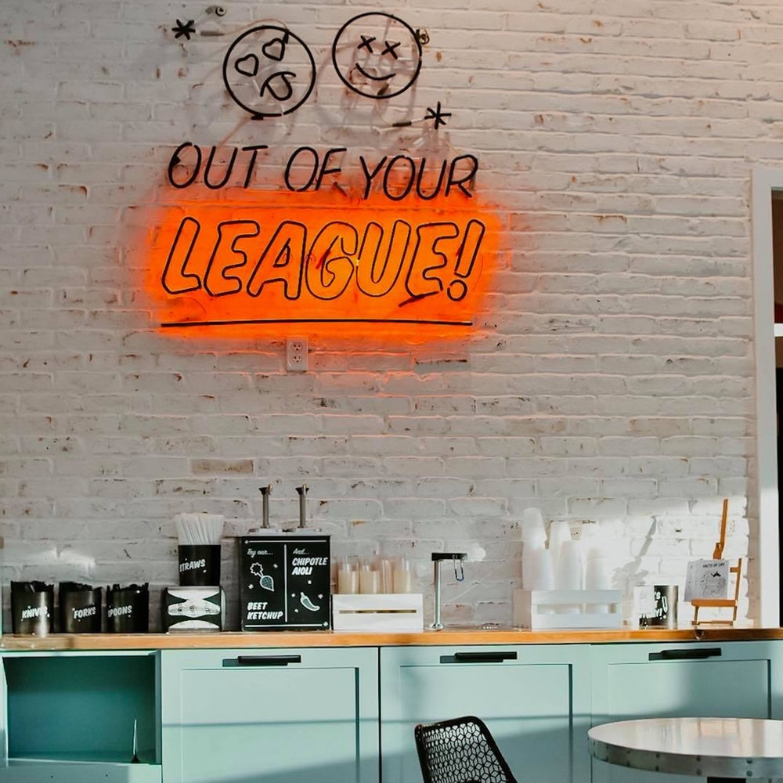
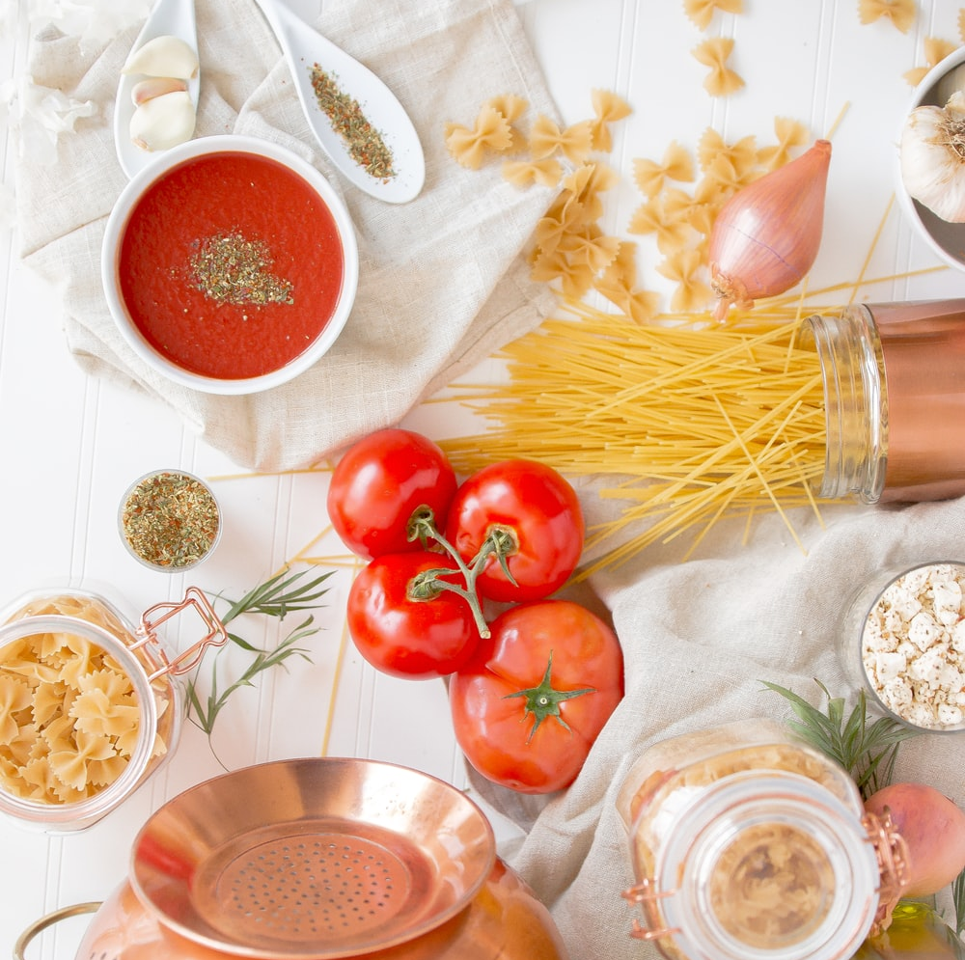
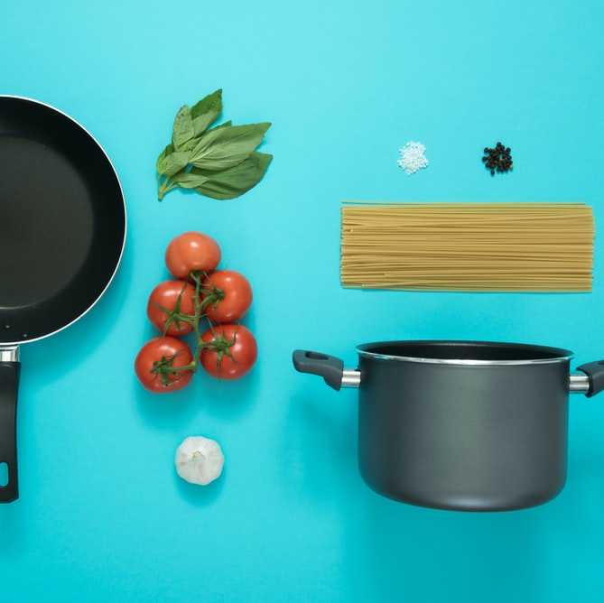
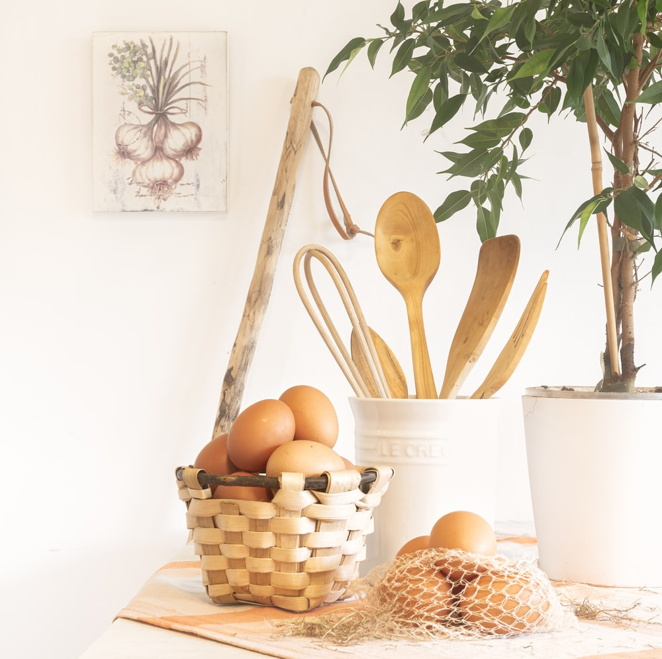
Spaghetti
Why it works and why we like it:
We want to feed the theme of creative nourishment. Everyone is an artist, and we are open to any medium for the message
Challenges the expectations of the brand. Symbolizes out of the box, heightened thinking. It’s a change in direction from “how we’ve always done it” to “let’s try something surprising and new”
Like our Distributors, Spaghetti is a network that connects and comforts people
And we like it because it makes us happy; it brings us joy. We smile every time we say the name, we think our partners will too

Slide 19
Activation for Spaghetti
Art is life. Life needs nourishment. Spaghetti is nourishment. Therefore, art needs Spaghetti…
We intend to re-create some of the world’s greatest masterpieces in pasta and display them at LA Live during high-traffic events to announce the arrival of Spaghetti.
Just imagine:
Picasso in Penne
Botticelli in Bucatini
And wait till you see Michelangelo’s Macaroni
On Spaghetti Starry Night, we commission the world’s greatest PastArtists to recreate pasta versions of well-known masterpieces.
These works of art will initially be displayed at a private evening event for our stakeholders, catered by the freshest pasta restaurateurs DTLA has to offer.
We will also be giving out samples of Protein Pasta, made from Herbalife Nutrition products.
The art will stay on display for a few days at LA LIVE with our Instagram Handle and hashtag easily displayed. Then Spaghetti Starry Night disappears as magically as it appeared.
But this is just the start, this pasta travels. This is an event can be repeated around the world. Just imagine, Spaghetti Starry Night at Comic Con, for example.
When the bit runs out, that’s fine. We will find a home for these masterpieces through an HNF auction.
In conjunction with Susan Bowerman, we will create a Protein Pasta Recipe – creatively using Herbalife Nutrition products.
We will host a Facebook Live event with Susan Bowerman
And share a recipe video and recipe card on Social Media.
Create hashtag and ask Distributors and Employees to share their pictures of their meals with Protein Pasta

Slide 20
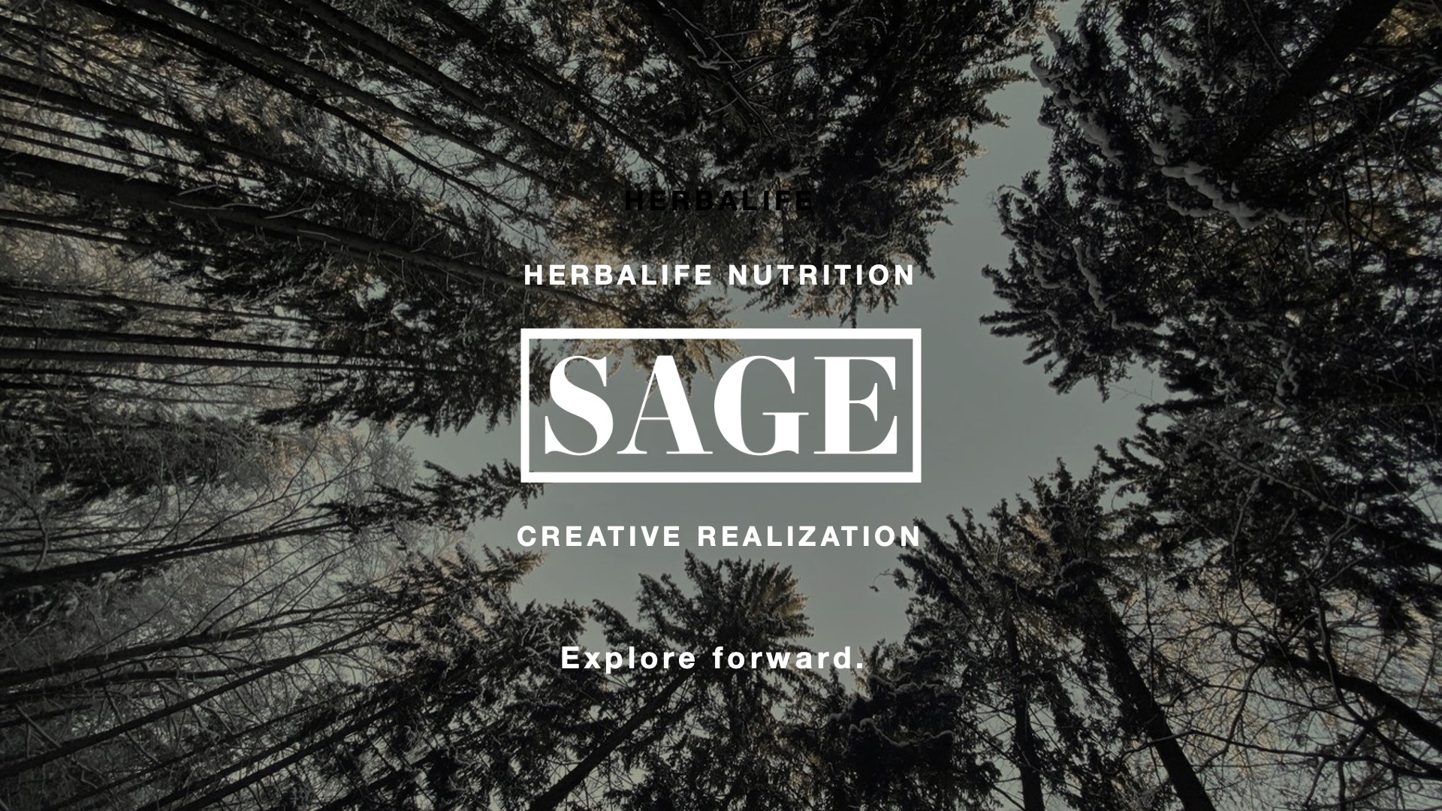
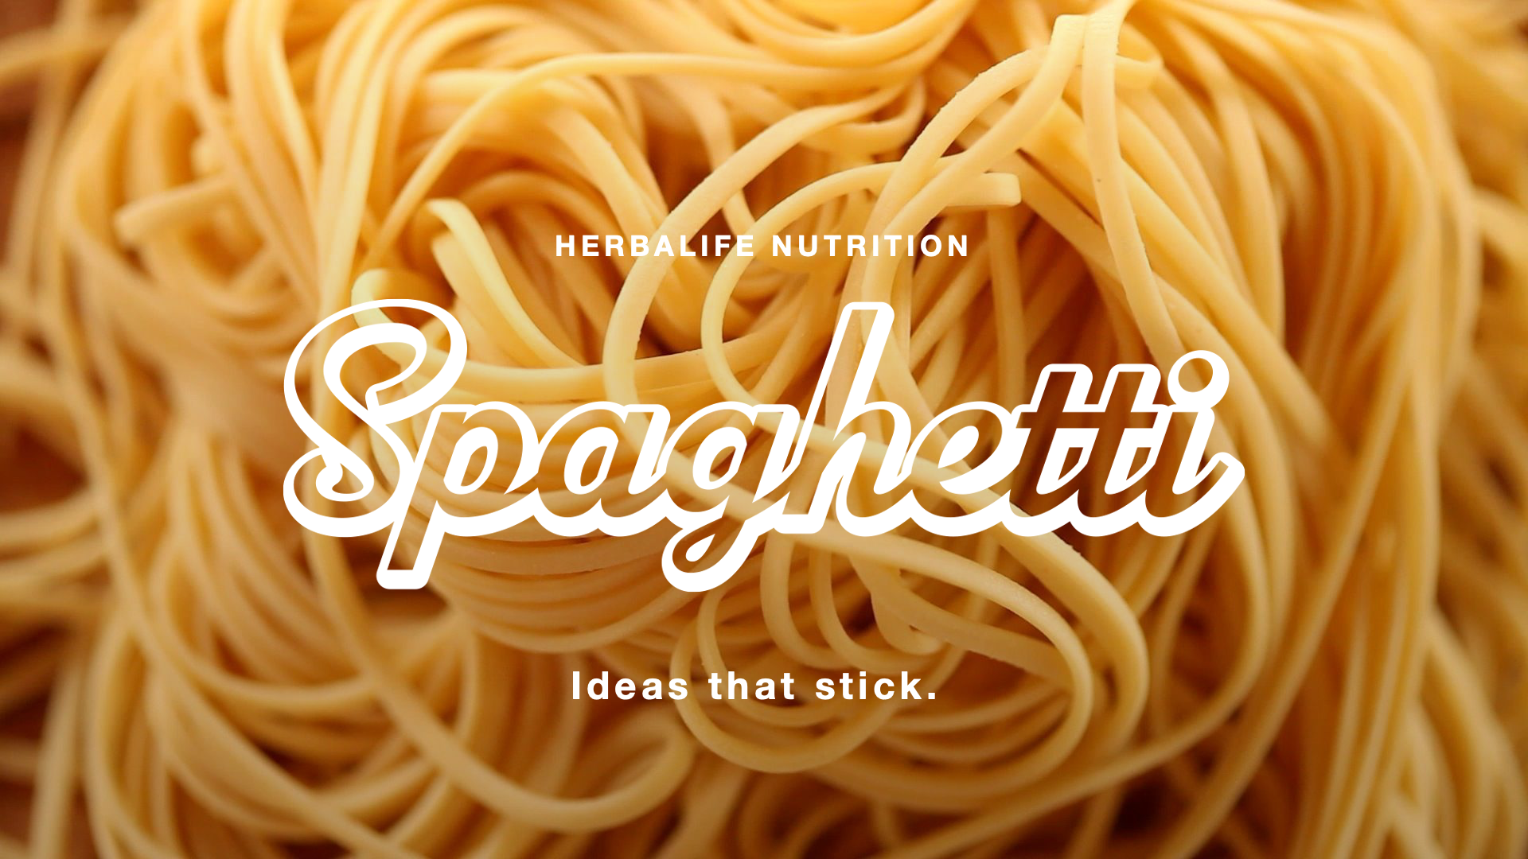
Summary

Slide 21
Thank you

