Slide 1
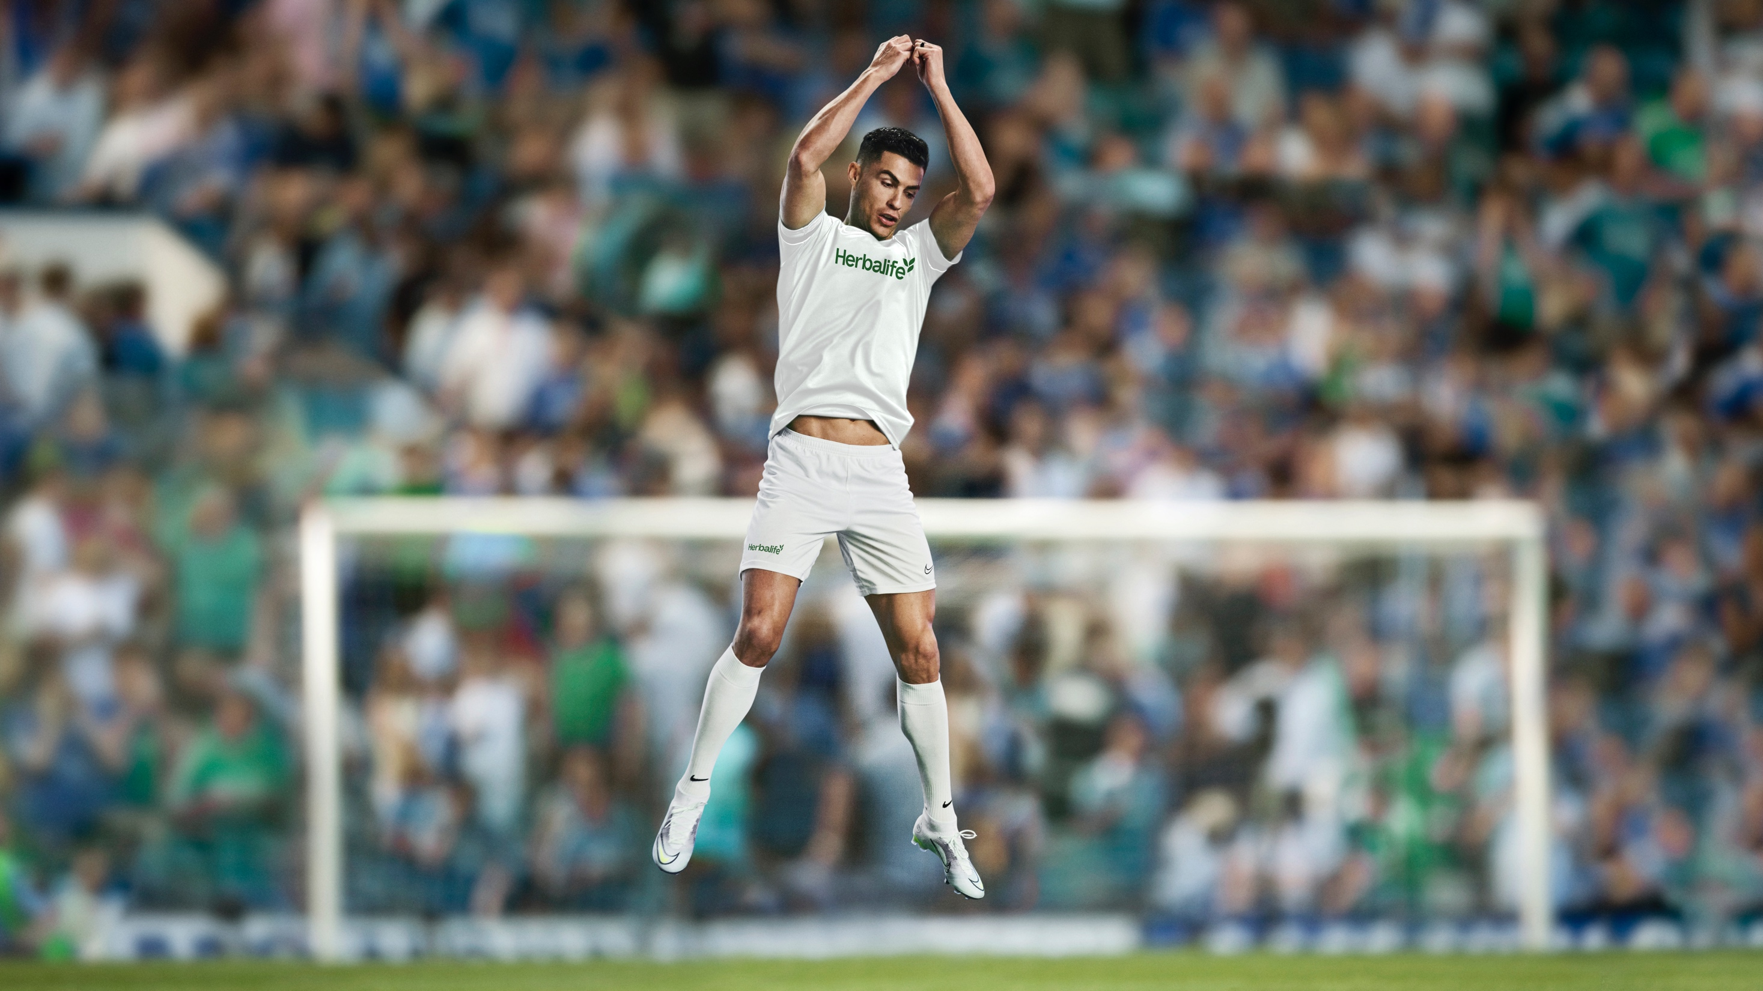
Creative and Strategy Update
2026 WORLD CUP
CAMPAIGN UPDATE

Slide 2
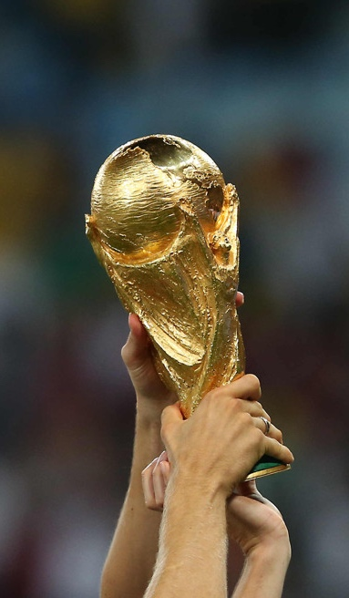
THE CAN’T MISS
OPPORTUNITY OF
Most popular sport in the world
FIFA world
cup is king
Super Bowl cannot keep up
4+ BILLION
Soccer fans across the world, making it by far the most popular sport on earth
5 BILLION
People engaged during the FIFA World Cup 2022 across all platforms
180 MILLION
Global Super Bowl viewers, but 125 million are in the United States
250 MILLION
People play soccer worldwide, making it the most widely played sport on earth
1.5 BILLION
Viewers of the FIFA World Cup 2022 Final between Argentina and France
80% DECREASE
In Google Search interest from Super Bowl Sunday to the Tuesday after

Slide 3
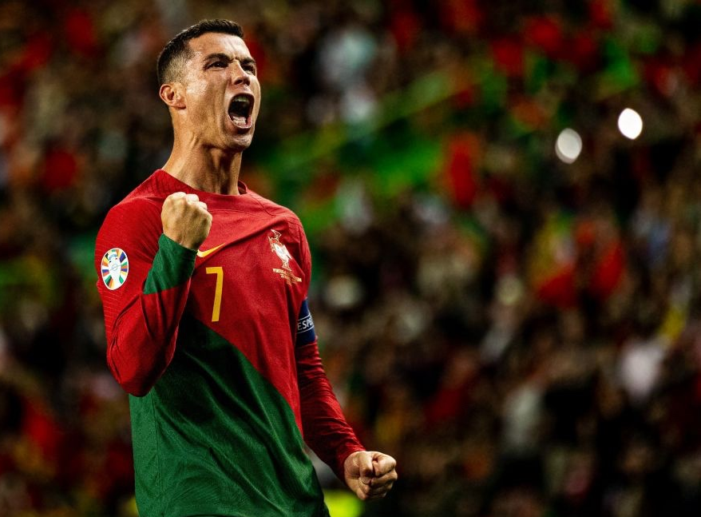
OBJECTIVE
Develop a creative campaign that will be used globally for
the company’s world cup campaign targeting consumers and internal audiences.
Primary Goals
Create buzz and excitement to help strengthen the Herbalife brand in global football community.
Support and accelerate the global Distributor business.
Entice World Cup fans to want to learn more about Herbalife.
Inspire and excite internal stakeholders—Executives, Board Members, Distributors, employees, and global markets.
Tone & Style
Inspirational
Bold, emotional
High-energy

Slide 4
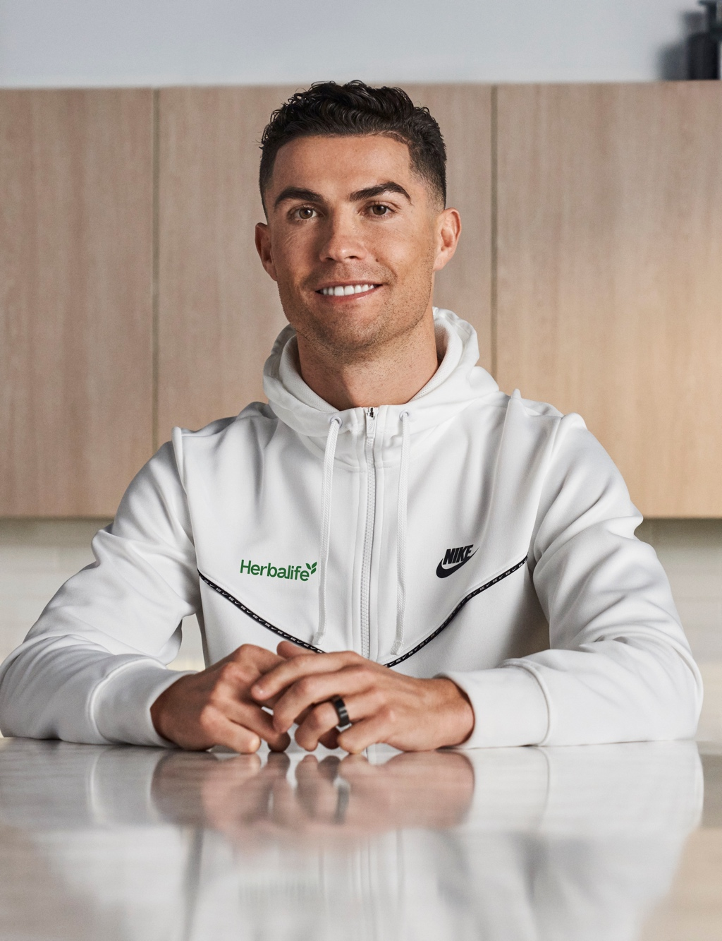
COPY
Fuel Like Ronaldo
Game day performance every day
Fuel Like
Make each goal count

Slide 5
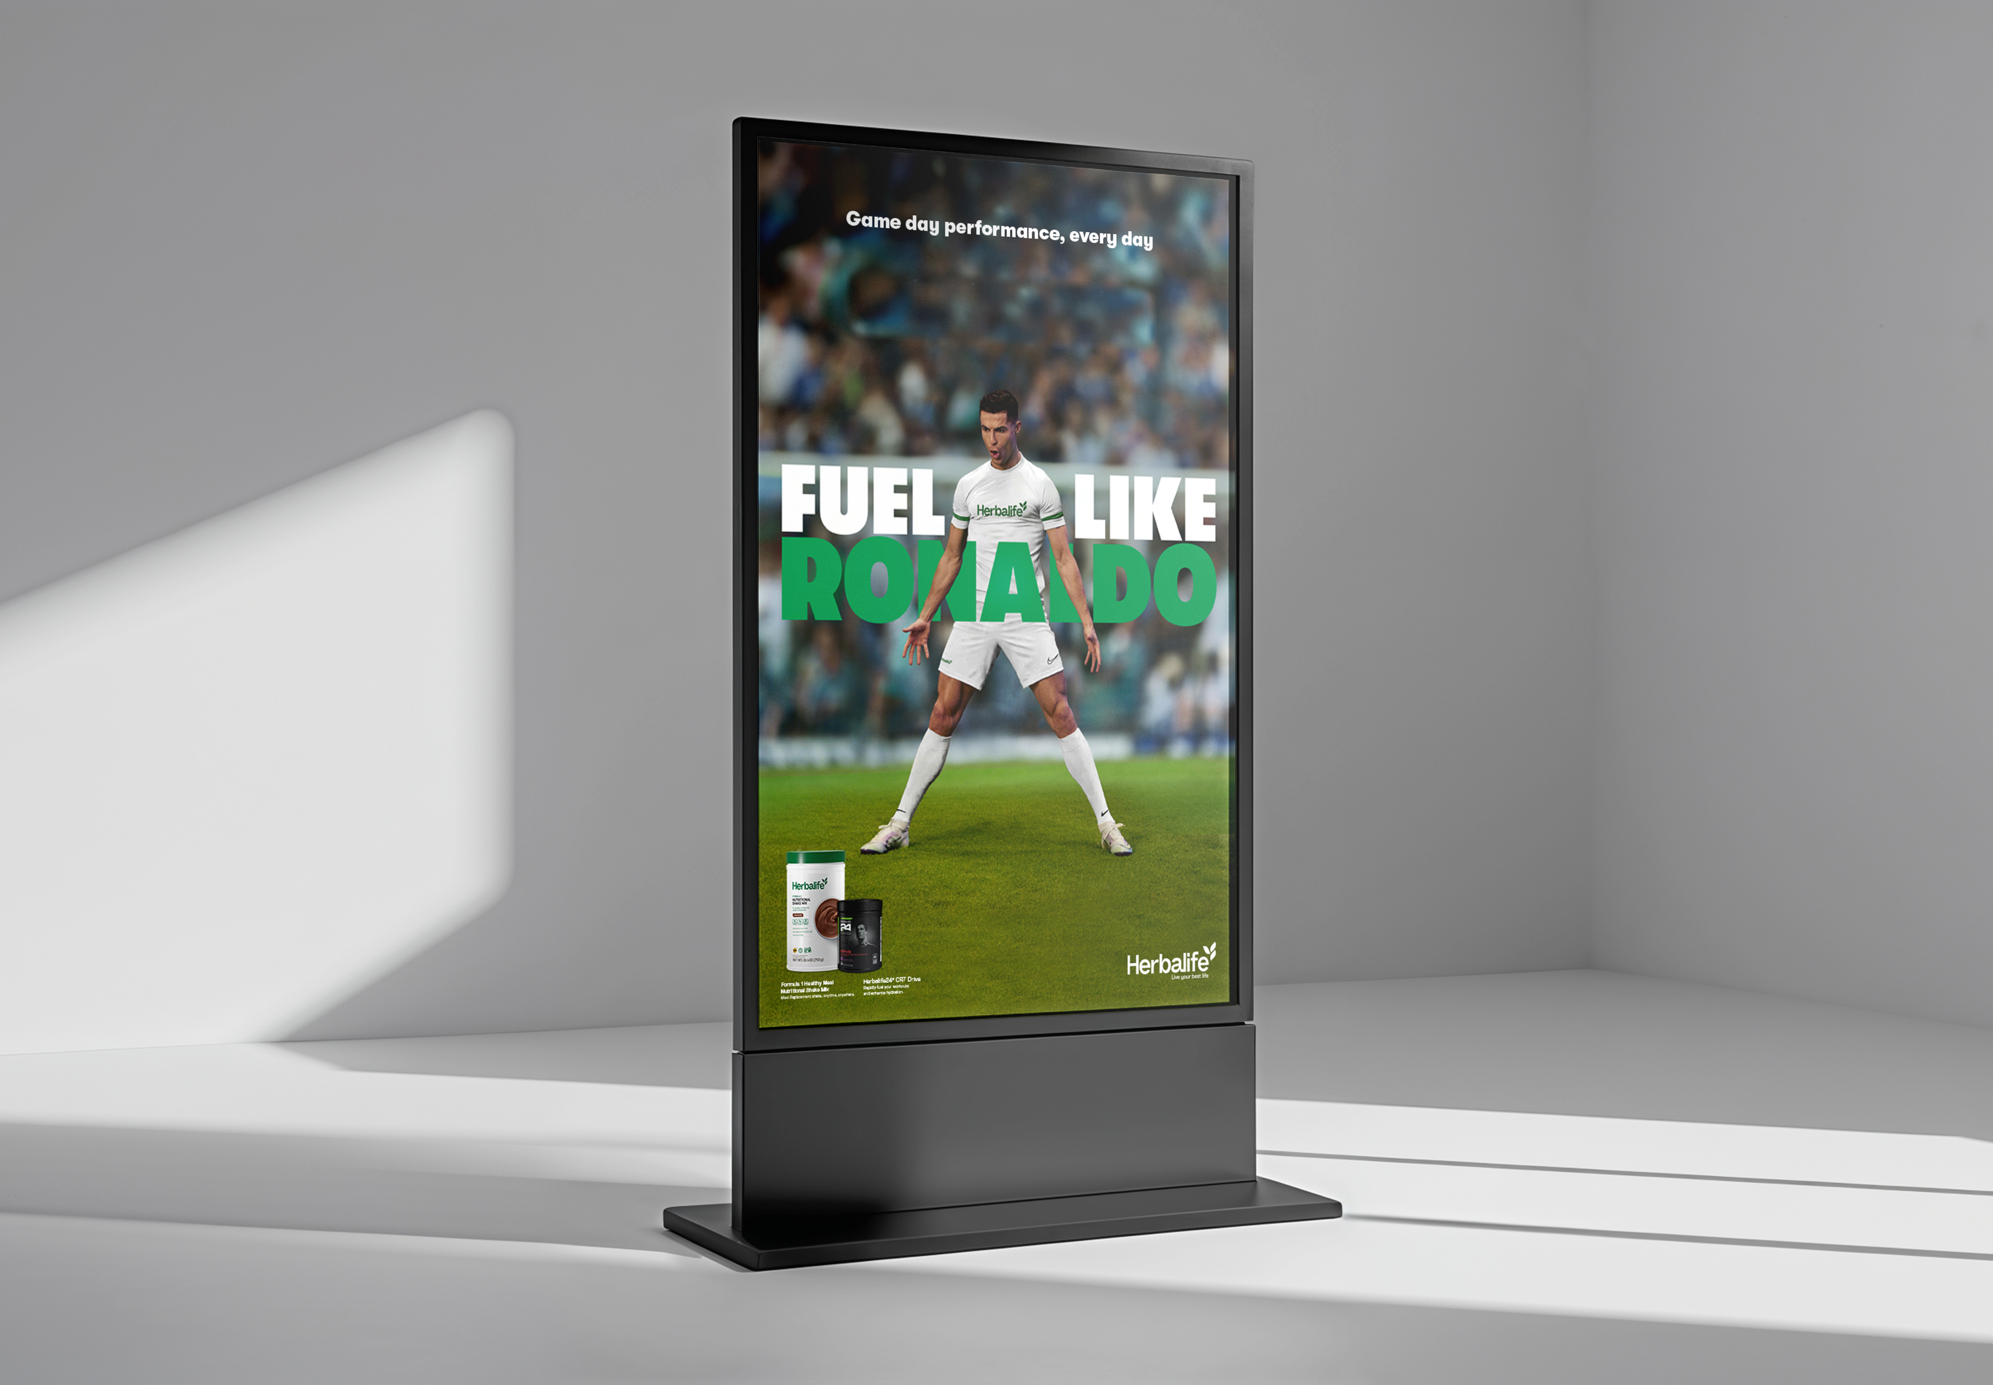
Concept 1
Fuel Like Ronaldo
Game day performance, every day
Match Ronaldo’s game day mindset and bring it into your everyday life. The focus here is daily wins in each person’s journey. We support peak performance beyond the stadium, creating healthy daily habits. The design balances intensity with a championship feel, pairing powerful, focused imagery of Ronaldo with clean layouts

Slide 6
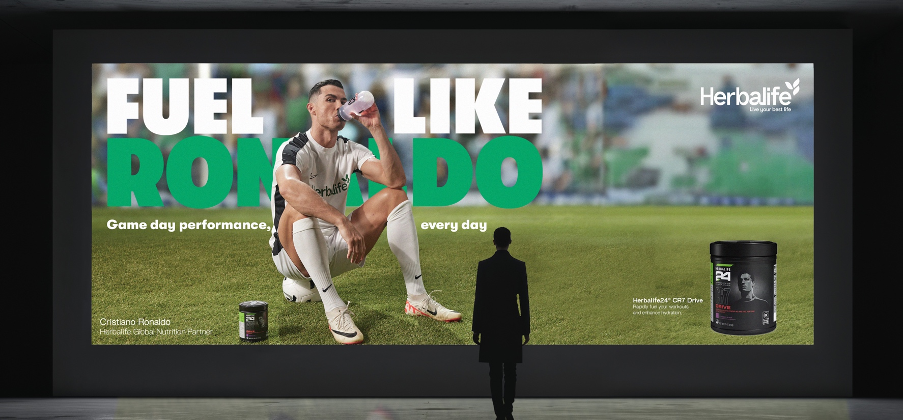
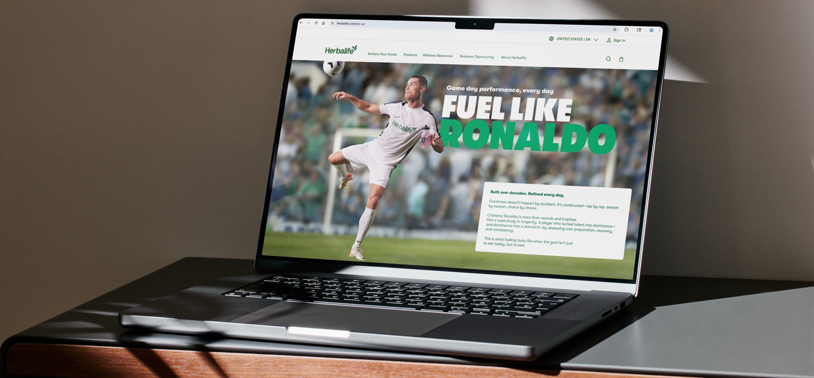

Slide 7
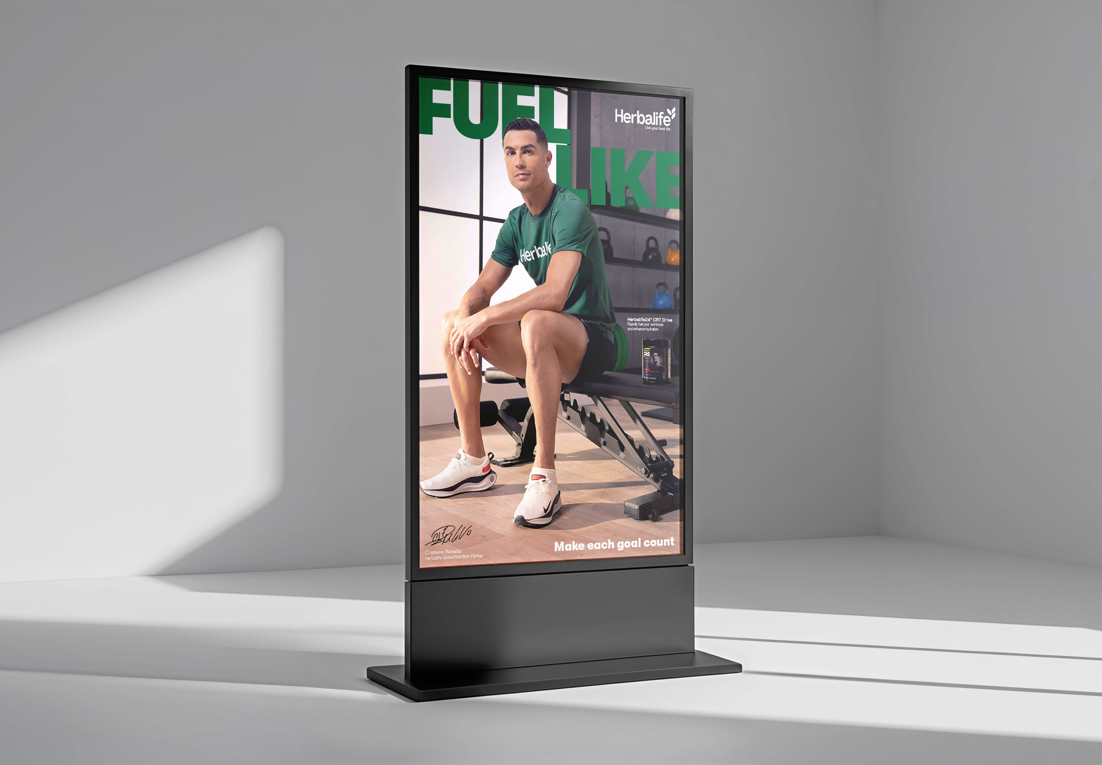
Concept 2
Fuel Like
Make each goal count
Ronaldo is pursuing his 1000th goal. Each one unique. Each one is a part of his lifelong legacy. This concept focuses on personal potential and embracing the journey.
The design is more human and reflective, using confident
yet approachable visuals that highlight strength, focus, and inner drive. It’s less about the moment of victory and more about the journey toward becoming your best self. We have dropped his name on this option, letting the visual tell the story.
We know that achieving your goals, no matter how big or how small, paves the road to success. And each one counts.

Slide 8
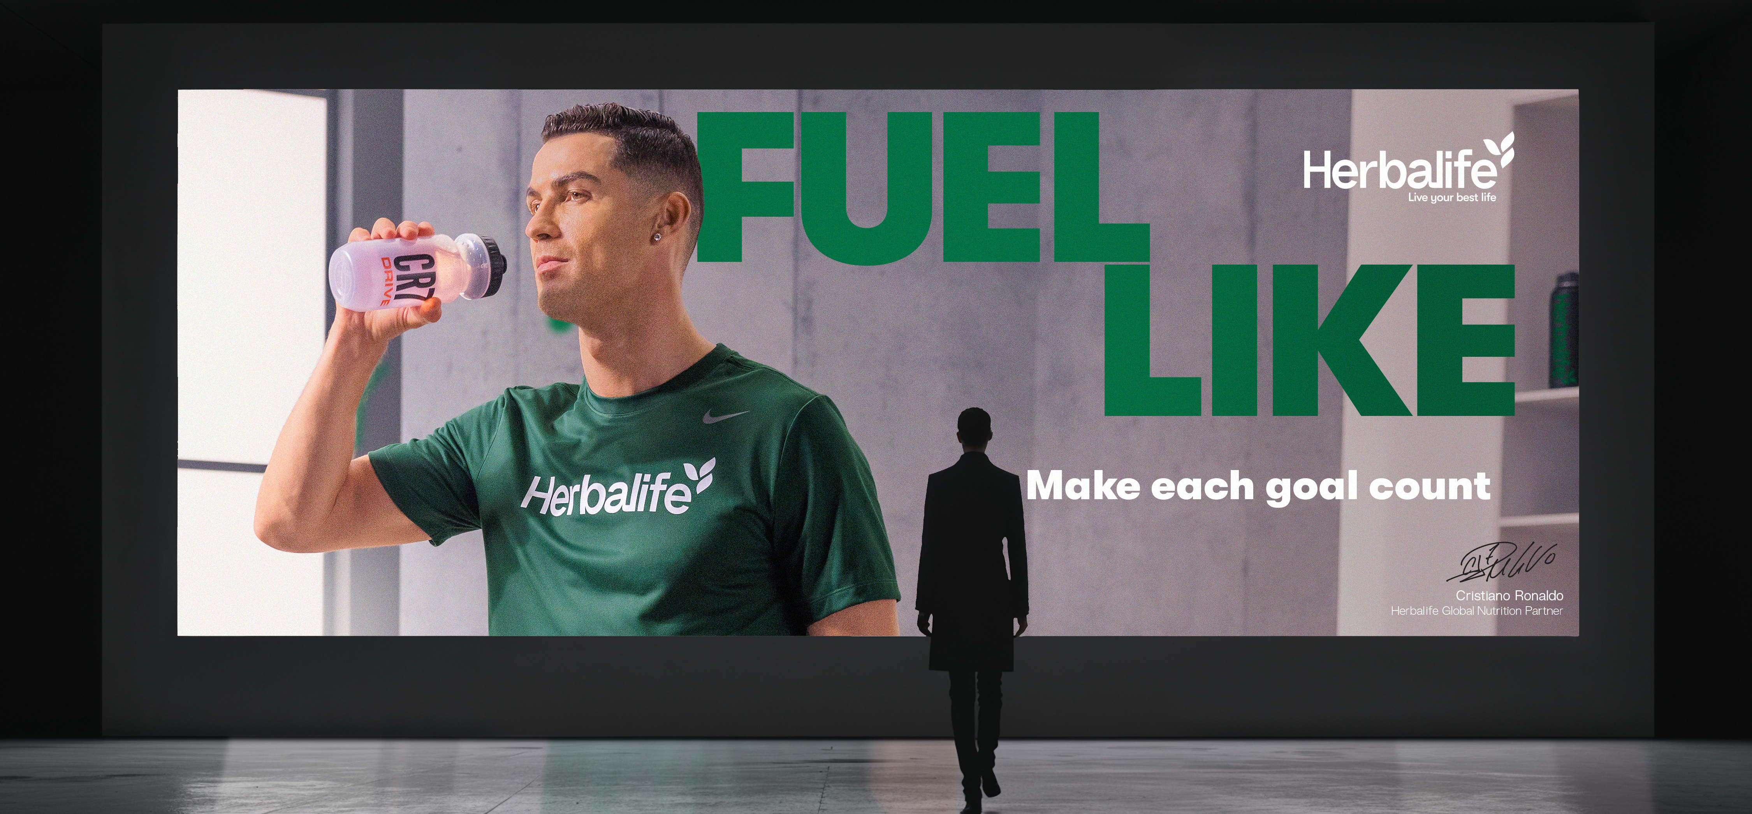
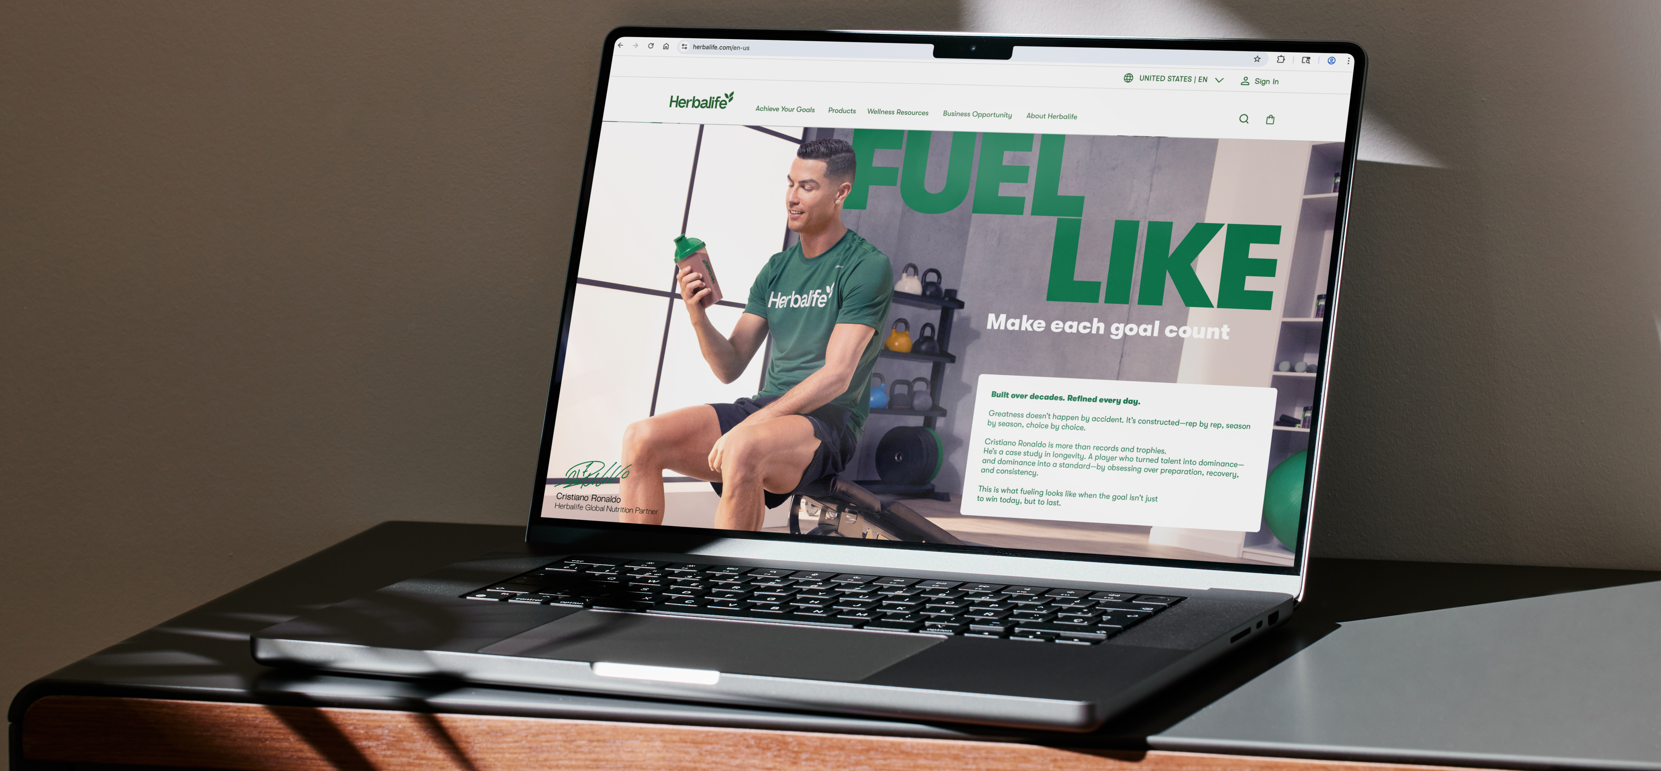

Slide 9
1
2

